Slide 1

USWDS Monthly Call
January 2024

Slide 2

Hi!
Thanks for being here!

Slide 3
Agenda
Site launches
Product updates
Launching accessibility tests
Q&A

Slide 4
Site launches

Slide 5
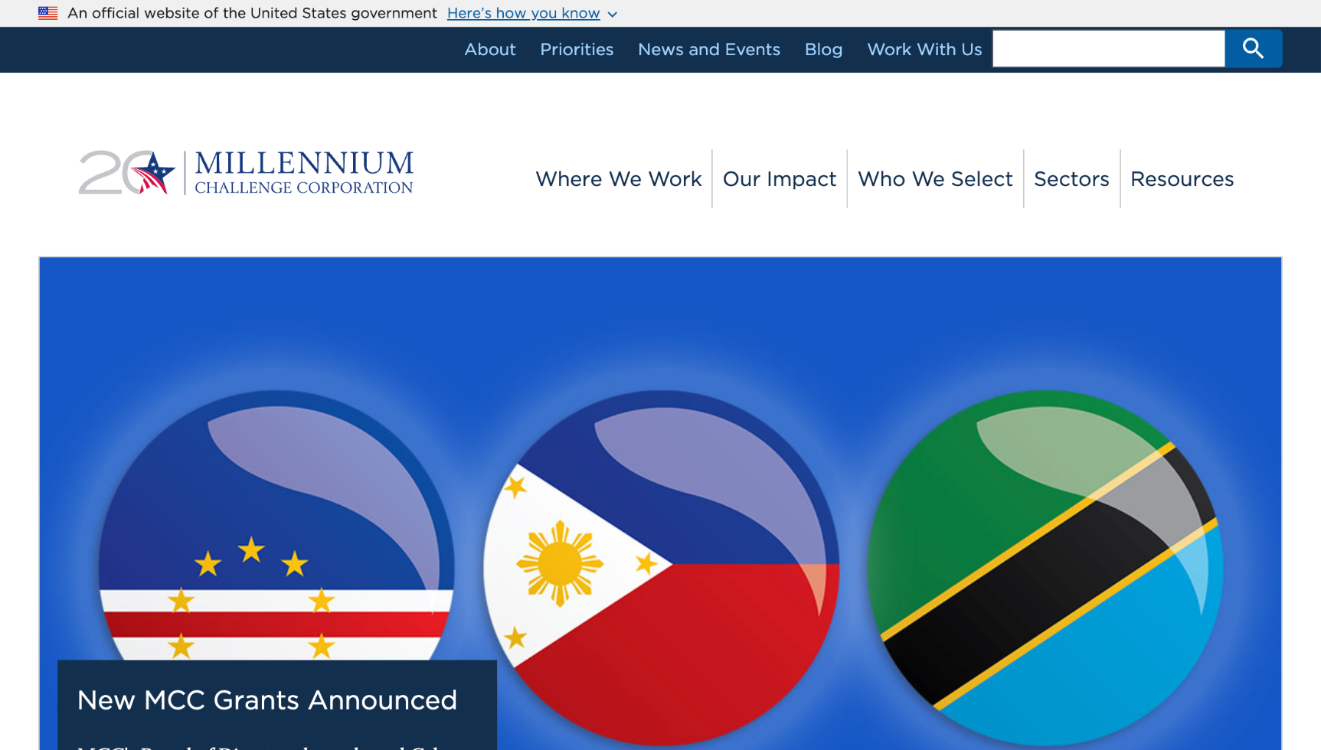
Millennium Challenge Corporation
mcc.gov

Slide 6
Great work!

Slide 7
Product updates

Slide 8
USWDS 3.8.0
Community contributions

Slide 9
Key improvements in USWDS 3.8.0
Adding support for sticky headers in tables
Better text wrapping and alignment in button groups
Improved icon alignment in buttons
More control over headings included in in-page navigation
Adding contrast checking for disabled elements
Adding support for indeterminate checkboxes

Slide 10
USWDS 3.8.0
Coming in January

Slide 11
Quarterly roadmap update

Slide 12

Roadmap update:
Web components
Upcoming milestones
January 2024
Plan for working group
January 2024
Plan for sequencing/scheduling
February 2024
Requirements draft
March 2024
Release core components alpha
June 2024
Form components beta
Mature Beta: October 2024

Slide 13
Roadmap update:
JSON tokens
Upcoming milestones
January 2024
Finish landscape analysis
January 2024
Finalize data structure
April 2024
Our site powered by JSON tokens
May 2024
Theme and state tokens converted
May 2024
Demo color tokens in style dictionary
Mature Beta: October 2024

Slide 14
Roadmap update:
Component lifecycle
Upcoming milestones
January 2024
Proposal status page prototype
January 2024
Clarify roles and responsibilities
February 2024
Software lifecycle definitions
February 2024
Establish proposal repo
March 2024
Documentation available on our site
March 2024

Slide 15
Roadmap update:
Operationalizing usability research
Upcoming milestones
January 2024
Round 2 ("Zebra") research plan
January 2024
Publish recruitment page
February 2024
Conduct Round 2 research
March 2024
Document Round 2 findings
April 2024
Create cadence for ongoing research; plan for Round 3
May 2024

Slide 16
Roadmap update:
Website content audit
Upcoming milestones
February 2024
Complete page-level analysis
February 2024
Finalize success metrics
March 2024
Document repeatable process
March 2024

Slide 17

Roadmap update:
Top tasks
Upcoming milestones
January 2024
Document usability tests
January 2024
Add signup form to Touchpoints
April 2024
Perform usability tests
May 2024
Synthesize and document findings
May 2024

Slide 18
Roadmap update:
Disabled states research update
Upcoming milestones
February 2024
Finalize guidance updates
April 2024
Finalize communications plan
May 2024
Publish supporting research
June 2024
Update site guidance
June 2024

Slide 19
Roadmap update:
Critical checklists
Upcoming milestones
January 2024
Publish first tests
March 2024
Next round of usability testing
July 2024
Complete first pass of testing
August 2024
Complete second pass of testing
August 2024
Finish publishing all component tests
August 2024

Slide 20
Roadmap overview → GitHub
github.com/orgs/uswds/projects/8/views/31

Slide 21
Launching accessibility tests
Making accessibility more accessible

Slide 22
Launched project in June 2023

Slide 23
Project goals:
Transparency

Slide 24
Project goals:
Simplicity and clarity

Slide 25
Project goals:
Empowering participation

Slide 26
It’s taken some time…

Slide 27
But this is important

Slide 28
Critical Checklists

Slide 29
Critical Checklists
Accessibility tests

Slide 30
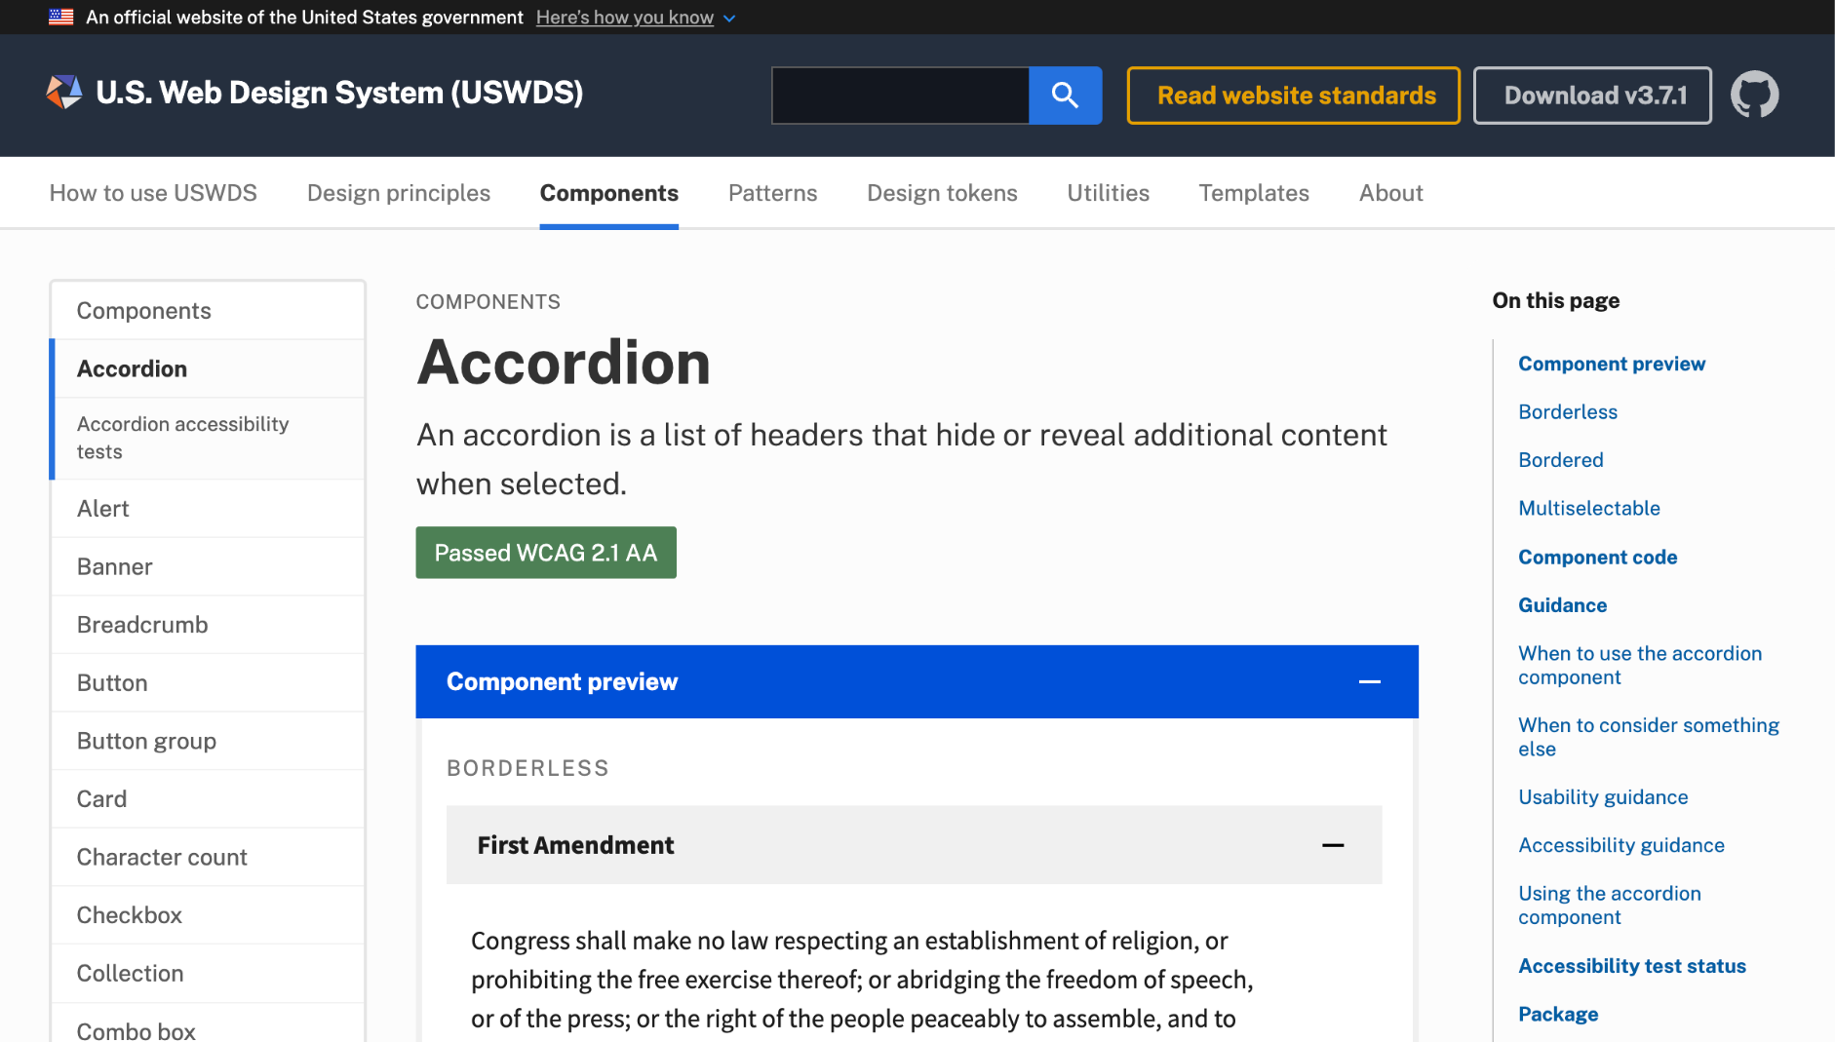
Accordion component page
designsystem.digital.gov /components/accordion

Slide 31
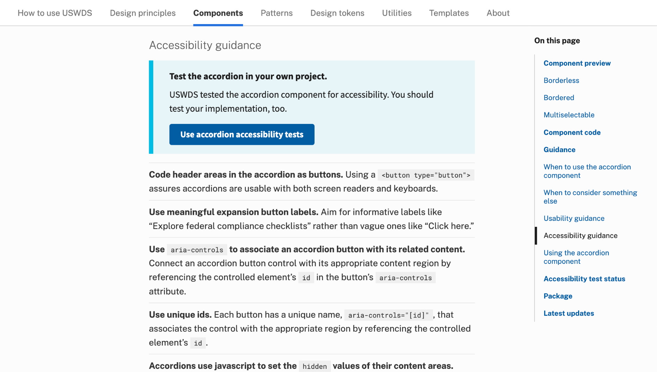
Accessibility guidance callout

Slide 32
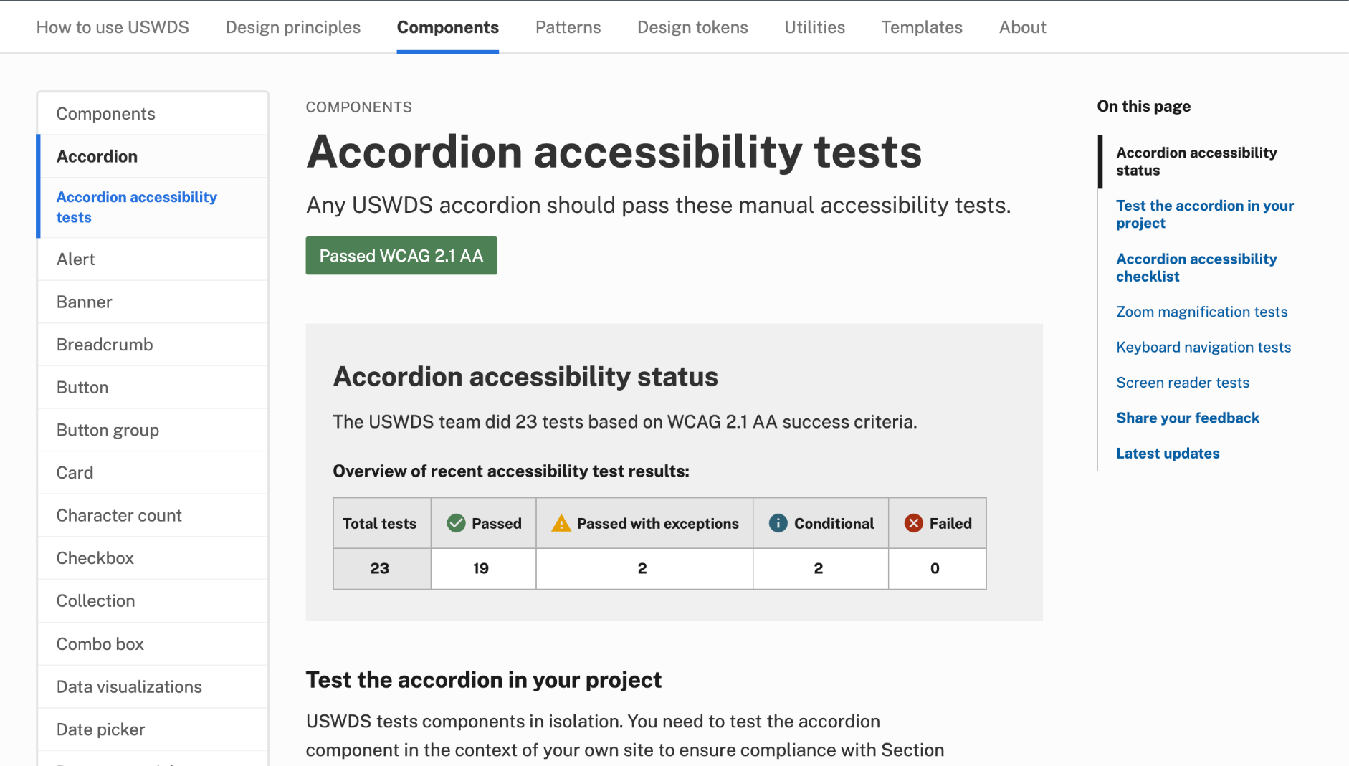
Accordion accessibility tests
designsystem.digital.gov /components/accordion/accessibility-tests

Slide 33
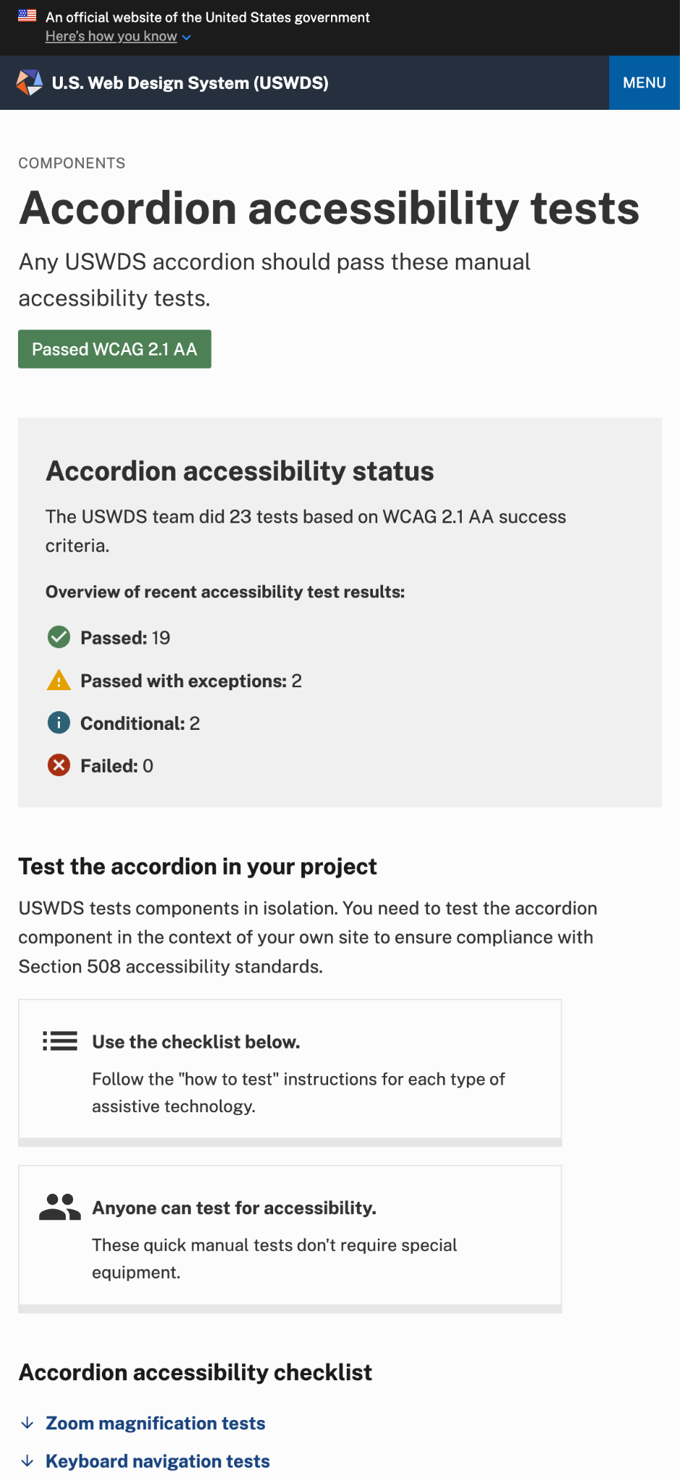
Introduction
Accessibility status and testing in your own project

Slide 34
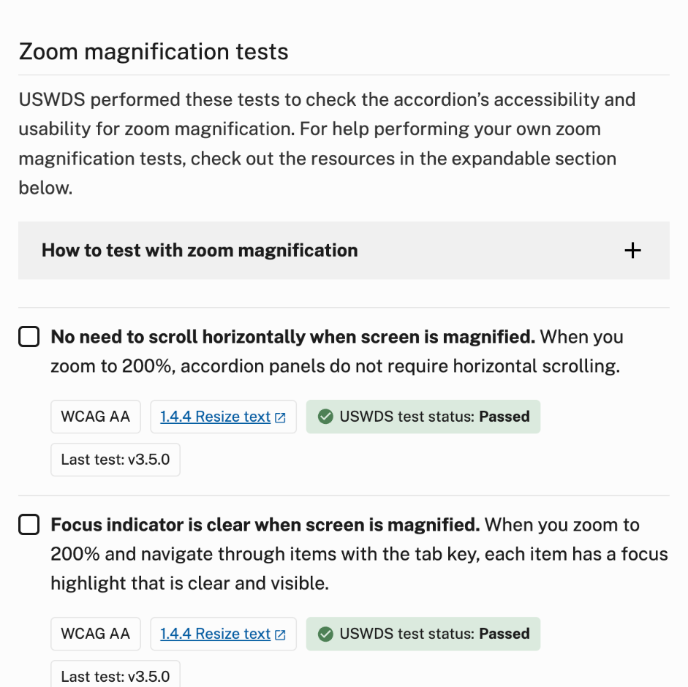
Accessibility tests
Checklists organized by type of test

Slide 35
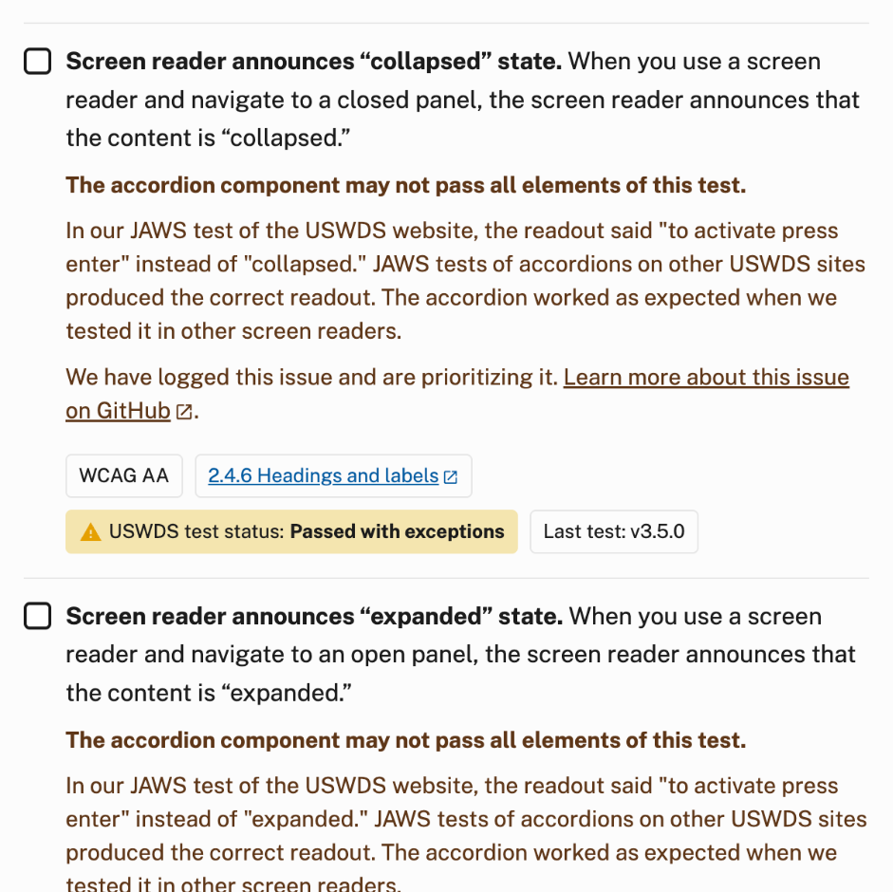
Passing with exceptions
Documenting the context for exceptions

Slide 36
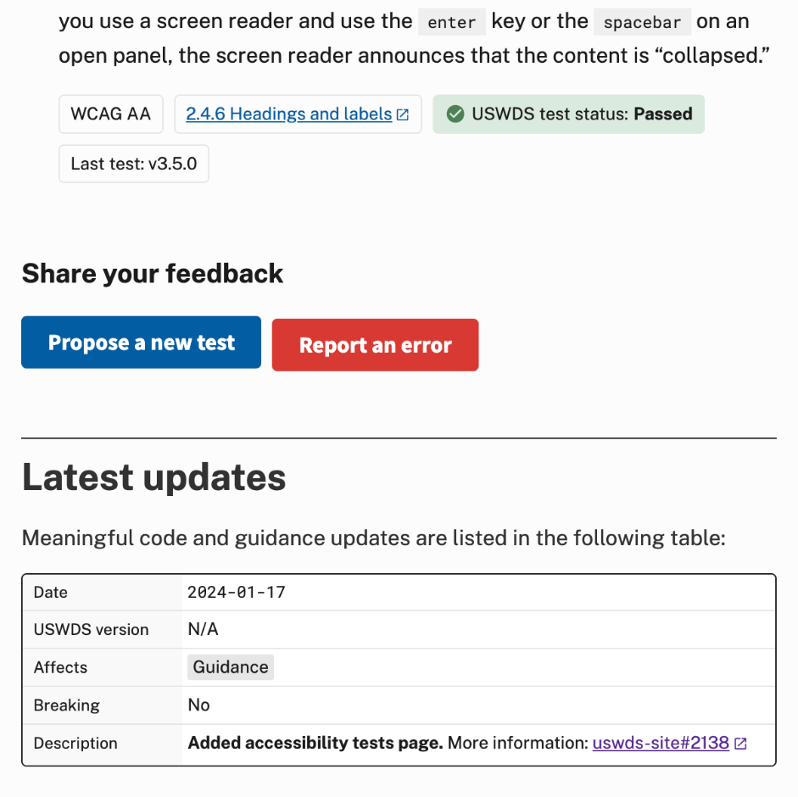
Calls to action
Proposing a new test or reporting an error

Slide 37
What we’ve published

Slide 38
What comes next

Slide 39
Schedule

Slide 40
Checking back in on goals:
Making accessibility more accessible

Slide 41
Checking back in on goals:
A baseline for change

Slide 42
Checking back in on goals:
Scaling expertise

Slide 43
Amy Cole
she/her
Accessibility Expert USWDS Contractor

Slide 44
Jacline Contrino
she/her
UX Researcher
USWDS Contractor

Slide 45
Anne Petersen
they/them
Experience Design Lead
USWDS

Slide 46
Accessibility
Understanding what to test

Slide 47
So with these goals in mind…

Slide 48
What are success criteria? What are we measuring against?

Slide 49
We’re checking them in isolation

Slide 50
Determining relevant WCAG success criteria

Slide 51
How we sequenced our components

Slide 52
How we checked our components

Slide 53
How we wrote our test prompts
“When you [blank] , it [blanks] .”

Slide 54
Rechecking our work

Slide 55
How we’ll keep this going

Slide 56
What if we find an issue?

Slide 57
How to use these tests

Slide 58
How to participate

Slide 59
Usability research
Applying what we learned

Slide 60
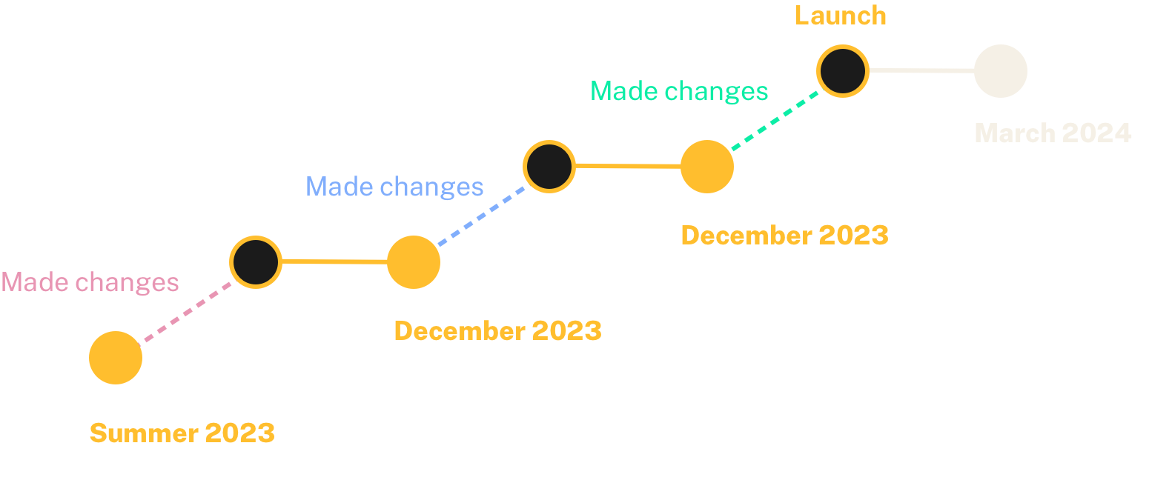
Iterative testing

Slide 61
Goal
Sample research questions:
Is the purpose of the page clear?
Is it useful and usable to someone who’s not an accessibility expert?
Is the page where they expect to find it?
What page title makes the most sense to participants?
Discover what improvements need to be made to better meet your needs.

Slide 62
Participants
Roles:
2 Senior Tech/IT Specialists
Software engineer
Communications Specialist
UI Designer
Mix of designer and developer
A11y experience:
2 experienced with it and do some manual testing
4 have little to no experience with manual testing
Tested with 6 users

Slide 63
Method
Participants viewed the prototype and gave feedback while sharing their screen.
We also asked them to use the checklist to do manual testing.
30 minute video call

Slide 64
What did we learn and how did it affect our design of the page?

Slide 65
Overall, people reacted positively to the page.
They said it is a unique, helpful resource that they would use as a reference.
“I think this is really great. I've never seen accessibility stuff explained in such plain language.”
“This is new and it’s interesting and it’s something I’m going to use moving forward.”

Slide 66
It’s easy to find.

Slide 67
Using the checklist to do manual testing was easy.

Slide 68
What could be improved?

Slide 69
So, is it compliant or not?
People wanted a clearer answer.

Slide 70
The purpose of the page was muddy.
Purpose 1
Communicate the tests we’ve done and the results of those tests.
Purpose 2
Help you test your own implementation.

Slide 71
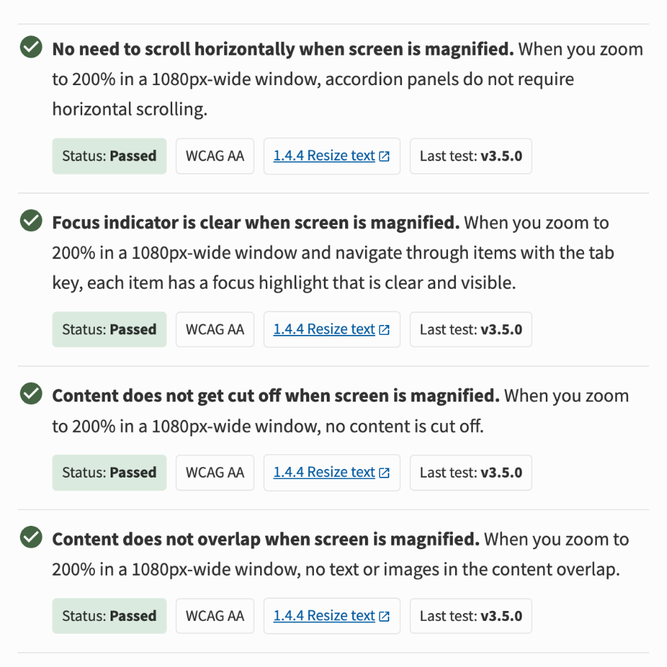
The presentation of the checks may have contributed to the confusion.

Slide 72
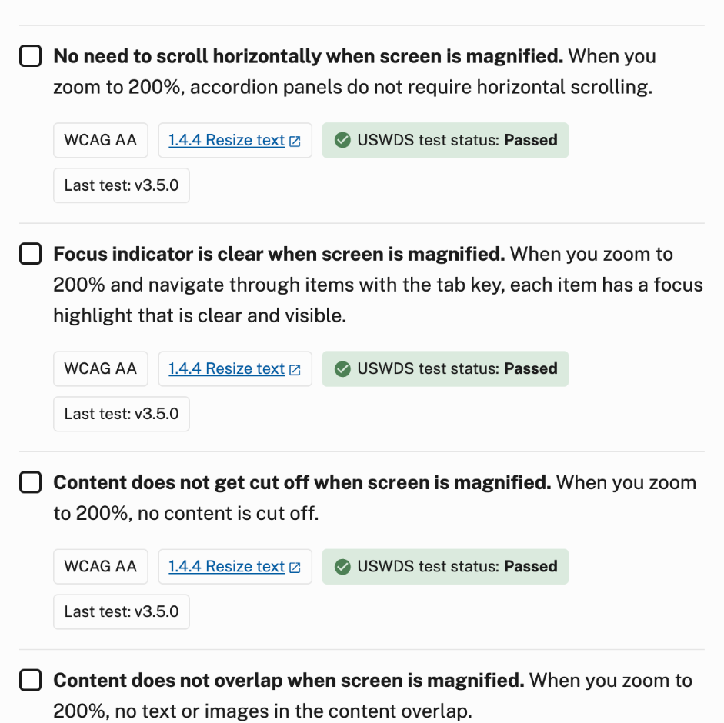
We made them look more interactive to make it clearer that although we tested them, you should test them, too.

Slide 73
The page was intimidating at first and seemed only for accessibility experts.
But once participants used the checks, they warmed up to the page.

Slide 74
The content was overwhelming and participants were missing critical information.

Slide 75
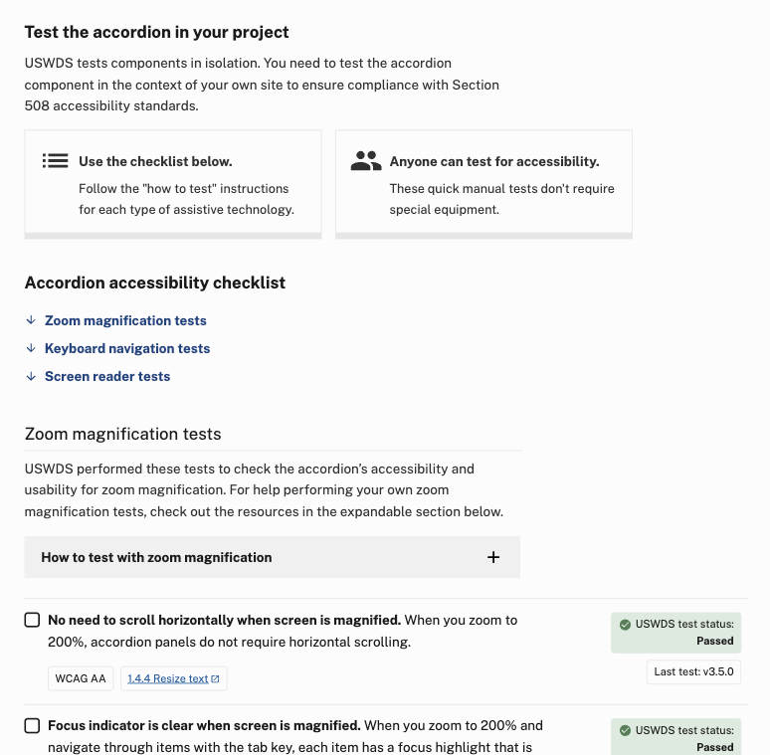
Reduced text
Used information chunking
Used more visual elements
Added jump links
Rearranged test status position

Slide 76
Naming the page was tricky.
‘[Component] accessibility tests’ covers the pages’ purpose well.

Slide 77
On the horizon…
More testing.

Slide 78
The work
Process as product

Slide 79
Our process is (part of) our product

Slide 80
What here is useful for you?

Slide 81
Make accessibility more accessible

Slide 82
Make informed decisions

Slide 83
Iterating

Slide 84
Always

Slide 85
The next

Slide 86
Q&A

Slide 87
Next month
February: Component lifecycle
#uswds-public
github.com/uswds
designsystem.digital.gov

